Slide 1
Adversarial CLIP
Chaewon Park (cp3227), Hnin Ookhin (ho2298)

Slide 2
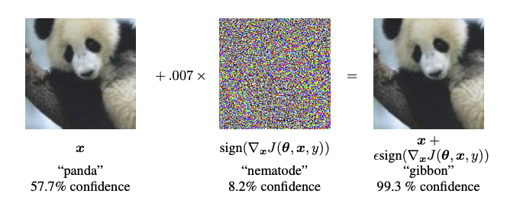
Adversarial Example
Problem Statement: “Testing Robustness of CLIP model on Adversarial Examples”
Notes:
Adversarial examples are specialised inputs created with the purpose of confusing a neural network, resulting in the misclassification of a given input. These notorious inputs are indistinguishable to the human eye, but cause the network to fail to identify the contents of the image. There are several types of such attacks, however, here the focus is on the fast gradient sign method attack, which is a white box attack whose goal is to ensure misclassification. A white box attack is where the attacker has complete access to the model being attacked. One of the most famous examples of an adversarial image shown below is taken from the aforementioned paper.
Here, starting with the image of a panda, the attacker adds small perturbations (distortions) to the original image, which results in the model labelling this image as a gibbon, with high confidence. The process of adding these perturbations is explained below.
An intriguing property here, is the fact that the gradients are taken with respect to the input image. This is done because the objective is to create an image that maximises the loss. A method to accomplish this is to find how much each pixel in the image contributes to the loss value, and add a perturbation accordingly. This works pretty fast because it is easy to find how each input pixel contributes to the loss by using the chain rule and finding the required gradients. Hence, the gradients are taken with respect to the image. In addition, since the model is no longer being trained (thus the gradient is not taken with respect to the trainable variables, i.e., the model parameters), and so the model parameters remain constant. The only goal is to fool an already trained model.

Slide 3
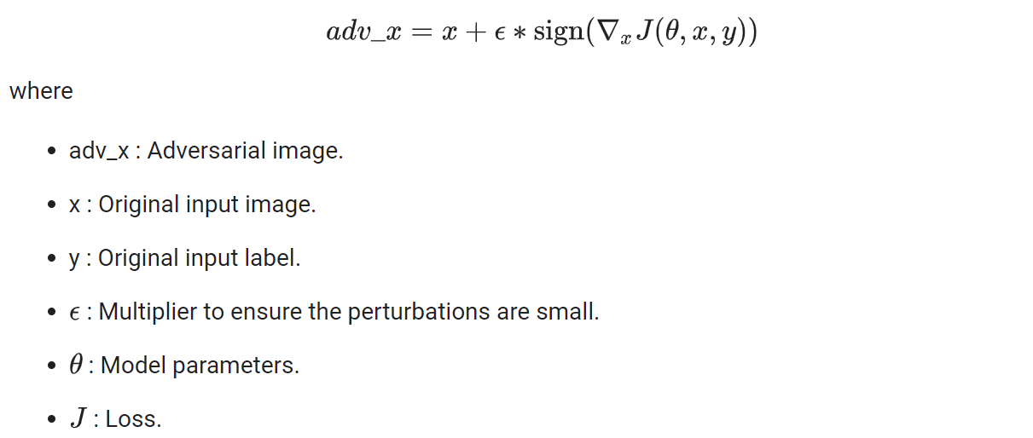
FGSM & PGD on ImageNet & Flickr Dataset
FGSM
PGD
Notes:
FGSM assumes the subspace in which adversarial examples exist are continuous and by adding perturbations to the image in the direction of the gradient’s sign, we can easily obtain numerous adversarial examples.
PGD is a method proposed by Madry which overcomes the downsides of FGSM. FGSM may not work if the loss function landscape is noisy and moving a step in the direction of the steepest gradient may not lead to the best adversarial example. Hence, instead of taking ‘one’ step in the gradient direction, PGD takes ‘multiple’ steps to strategically find the highest loss point.

Slide 4
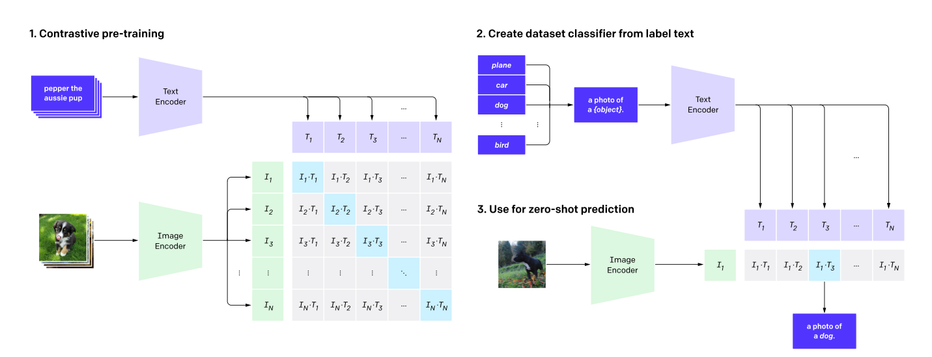
Contrastive Language-Image Pretraining (CLIP)
CLIP pre-trains an image encoder and a text encoder to predict which images are paired with which texts.
Create text from classifier label for zero-shot prediction.

Slide 5
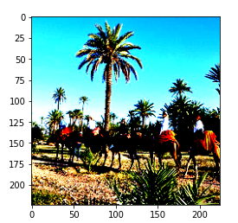
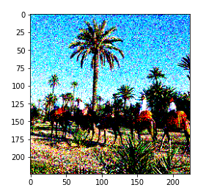
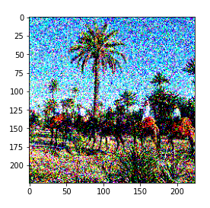
Fine-tuning: Gaussian Noise
Fine-tune on samples with Gaussian noise for the model to learn more generalizable features

Slide 6
Fine-tuning: Gaussian Noise
Top-5 Classification
 | Original ImageNet | PGD ImageNet | FGSM ImageNet
Baseline | 87.11 | 62.2 | 46.14
Gaussian (std=0.4) | 97.6 | 46.2 | 44.63
Gaussian (std=0.6) | 99.3 | 57.3 | 57.87
Gaussian (std=0.8) | 100 | 48.9 | 52.46
Gaussian (std=1) | 100 | 52.7 | 56.67

Slide 7
2. Fine-tuning (Adversarial Training): FGSM & PGD
Top-5 Classification
 | Original ImageNet | PGD ImageNet | FGSM ImageNet
Baseline | 87.11 | 62.2 | 46.14
Model Trained on PGD Flickr subset | 28.4 | 19.2 | 11.53
Model Trained on FGSM Flickr subset | 29.0 | 20.3 | 13.14
Reason for Degradation in Performance:
CLIP model was unstable when training with different learning rates (loss jumping)
May need to freeze some layers to retain pretrained information and stable training
Data distribution discrepancy between how each attack modifies Flickr and ImageNet

Slide 8
Next Steps
More data augmentation (Poisson, salt and pepper noise, cut-outs)
Freeze layers to improve stability of training
Regularizations: drop-out layers , skip connections

